Slide 1

Geometry
Unit 13, Lesson 5 Weighted Averages Volume 2, pg. 306

Slide 2


Benchmark
MA.912.GR.3.1
Determine the weighted average of two or more points on a line.
volume 2, pg. 306

Slide 3
Integrated Mathematical Thinking and Reasoning Standards
MA.K12.MTR.1.1 Actively participate in effortful learning both individually and collectively.
MA.K12.MTR.2.1 Demonstrate understanding by representing problems in multiple ways.
MA.K12.MTR.4.1 Engage in discussions that reflect on the mathematical thinking of self and others.
MA.K12.MTR.5.1 Use patterns and structure to help understand and connect mathematical concepts.
volume 2, pg. 306

Slide 4

Learning Targets
I can determine the weighted average of two or more points on a line.
I can explain how changing the weight moves the weighted average of points.
volume 2, pg. 306

Slide 5

Warm-Up
volume 2, pg. 306

Slide 6
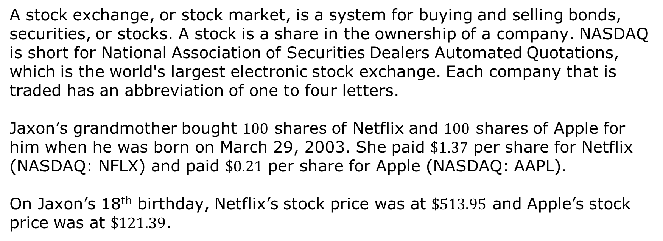
13.5.1 Warm-Up: Between Two Numbers
A stock exchange, or stock market, is a system for buying and selling bonds, securities, or stocks. A stock is a share in the ownership of a company. NASDAQ is short for National Association of Securities Dealers Automated Quotations, which is the world's largest electronic stock exchange. Each company that is traded has an abbreviation of one to four letters.
Jaxon’s grandmother bought $100$ shares of Netflix and $100$ shares of Apple for him when he was born on March 29, 2003. She paid $\$1.37$ per share for Netflix (NASDAQ: NFLX) and paid $\$0.21$ per share for Apple (NASDAQ: AAPL).
On Jaxon’s 18th birthday, Netflix’s stock price was at $\$513.95$ and Apple’s stock price was at $\$121.39$.
volume 2, pg. 306

Slide 7
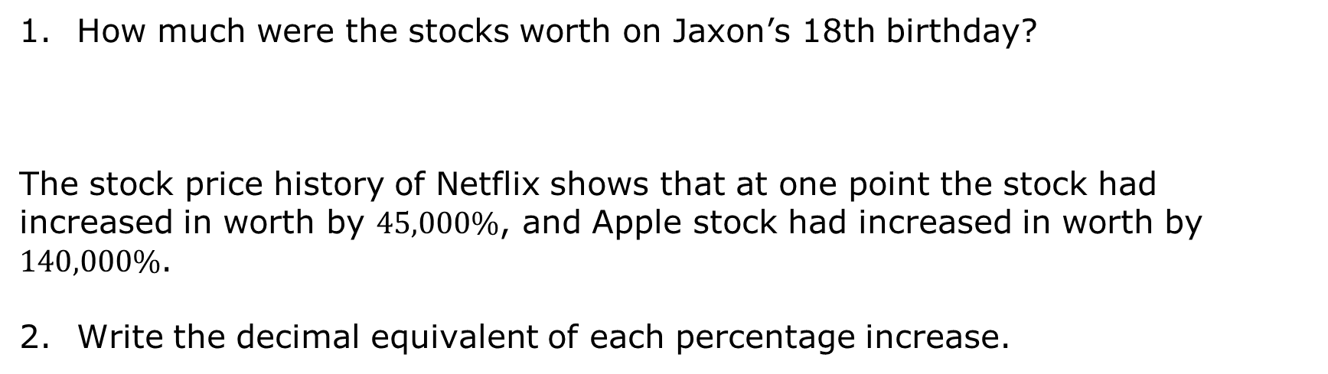
How much were the stocks worth on Jaxon’s 18th birthday?
The stock price history of Netflix shows that at one point the stock had increased in worth by $45,000\%$, and Apple stock had increased in worth by $140,000\%$.
Write the decimal equivalent of each percentage increase.
Stock | Decimal Equivalent
Apple
Netflix
volume 2, pg. 306

Slide 8

Exploration
volume 2, pg. 307

Slide 9

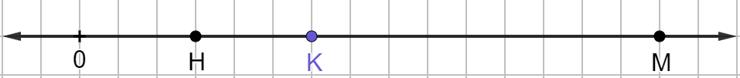
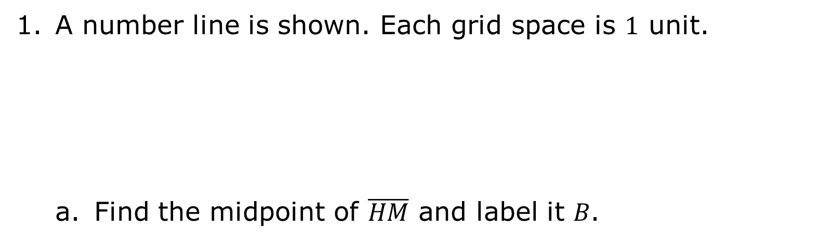
13.5.2 Exploration: Exploring Weighted Averages
A number line is shown. Each grid space is $1$ unit.
Find the midpoint of $\overline{HM}$ and label it 𝐵.
volume 2, pg. 307

Slide 10




Assuming that points 𝐻 and 𝑀 have the same weight, the diagram represents how points 𝐻, 𝐵, and 𝑀 are in balance.
Discuss with your partner why point 𝐵 acts as a point of balance. Summarize your discussion.
Keyshawn told his partner that if the scale is drawn where the scale is centered on point 𝐾, then point 𝐻 would be higher than point 𝑀. Describe or draw what would have to be done to balance the scale when it is centered at point 𝐾.
$$B$$
$$H$$
$$M$$
volume 2, pg. 307

Slide 11
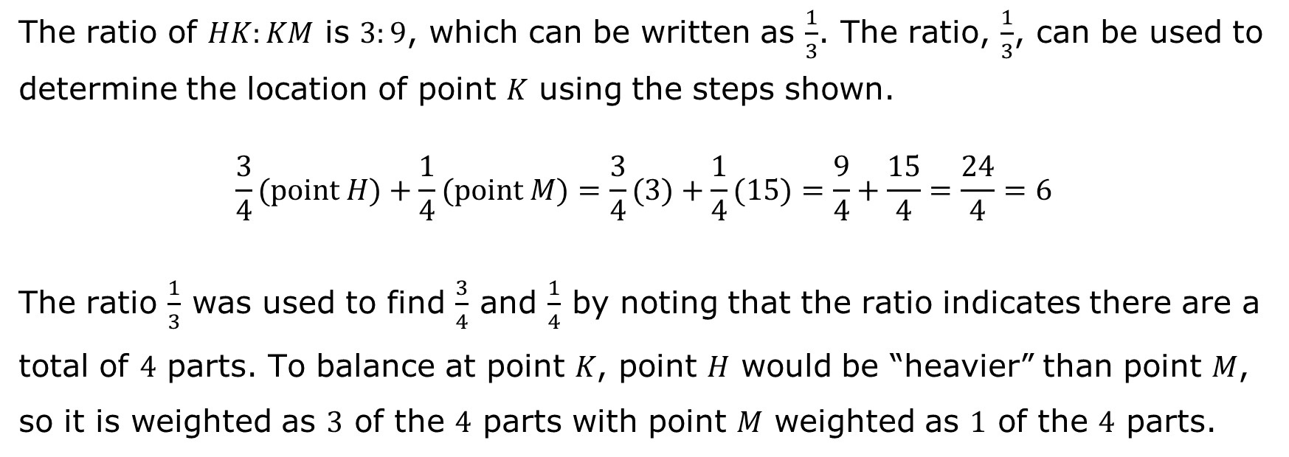
The ratio of $HK:KM$ is $3:9$, which can be written as $\frac{1}{3}$. The ratio, $\frac{1}{3}$, can be used to
determine the location of point 𝐾 using the steps shown.
$$\frac{3}{4}(point H)+\frac{1}{4}(point M)=\frac{3}{4}(3)+\frac{1}{4}(15)=\frac{9}{4}+\frac{15}{4}=\frac{24}{4}=6$$
The ratio $\frac{1}{3}$ was used to find $\frac{3}{4}$ and $\frac{1}{4}$ by noting that the ratio indicates there are a total of $4$ parts. To balance at point 𝐾, point 𝐻 would be “heavier” than point 𝑀, so it is weighted as $3$ of the $4$ parts with point 𝑀 weighted as $1$ of the $4$ parts.
volume 2, pg. 307

Slide 12
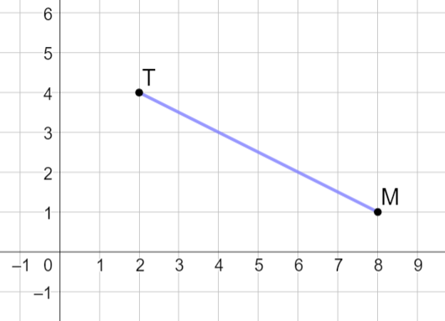

Point 𝑇 has coordinates $(2, 4)$, and point 𝑀 has coordinates $(8, 1)$.
What is the midpoint of line segment 𝑇𝑀?
volume 2, pg. 307

Slide 13
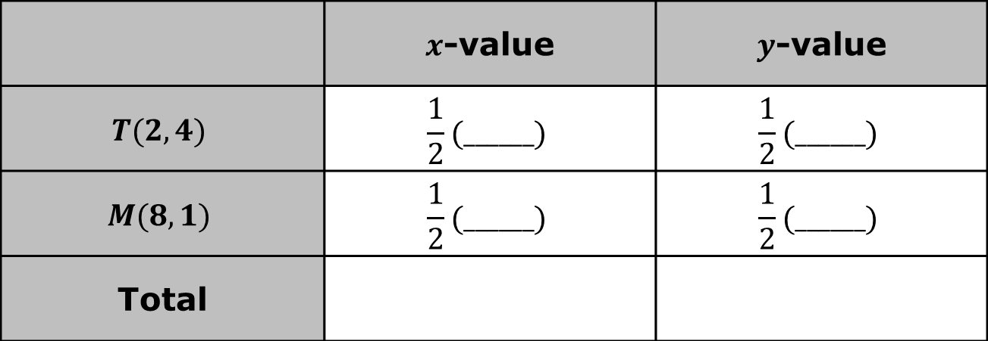
Complete the table.
Discuss with your partner how the table shows the process of finding the midpoint.
 | $x$-value | $y$-value
$$T(2, 4)$$ | $$\frac{1}{2}(______)$$ | $$\frac{1}{2}(______)$$
$$M(8, 1)$$ | $$\frac{1}{2}(______)$$ | $$\frac{1}{2}(______)$$
Total
volume 2, pg. 308

Slide 14
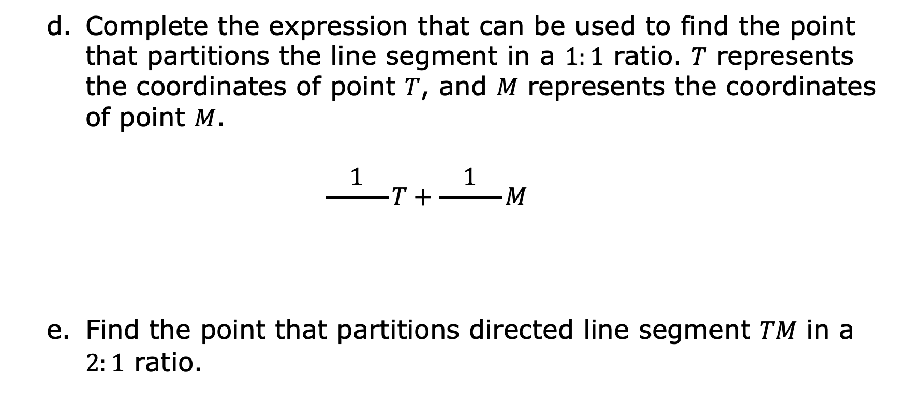
Complete the expression that can be used to find the point that partitions the line segment in a $1:1$ ratio. 𝑇 represents the coordinates of point 𝑇, and 𝑀 represents the coordinates of point 𝑀.
$$\frac{1}{ }T+\frac{1}{ }M$$
Find the point that partitions directed line segment 𝑇𝑀 in a $2:1$ ratio.
volume 2, pg. 308

Slide 15

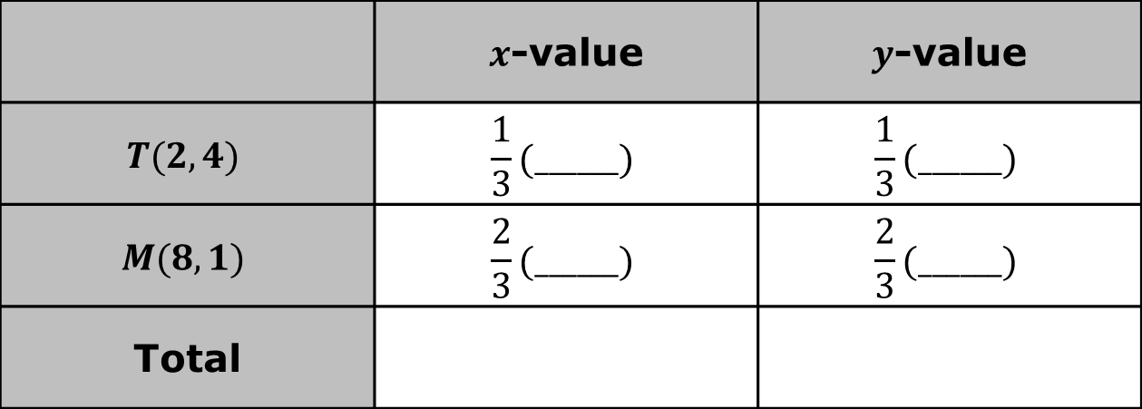
Complete the table to calculate $\frac{1}{3}T+\frac{2}{3}M$.
What do you notice about the total in the table and the point found in part e that partitions the directed line segment in a $2:1$ ratio?
 | $x$-value | $y$-value
$$T(2, 4)$$ | $$\frac{1}{3}(______)$$ | $$\frac{1}{3}(______)$$
$$M(8, 1)$$ | $$\frac{2}{3}(______)$$ | $$\frac{2}{3}(______)$$
Total
volume 2, pg. 308

Slide 16
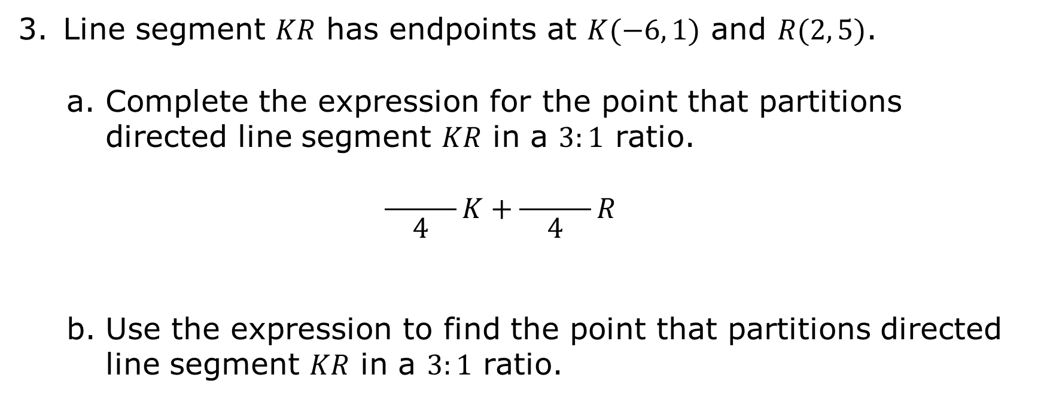
Line segment 𝐾𝑅 has endpoints at $K(−6, 1)$ and $R(2, 5)$.
Complete the expression for the point that partitions directed line segment 𝐾𝑅 in a $3:1$ ratio.
$$\frac{ }{4}K+\frac{ }{4}R$$
Use the expression to find the point that partitions directed line segment 𝐾𝑅 in a $3:1$ ratio.
volume 2, pg. 308

Slide 17

Guided Instruction
volume 2, pg. 309

Slide 18
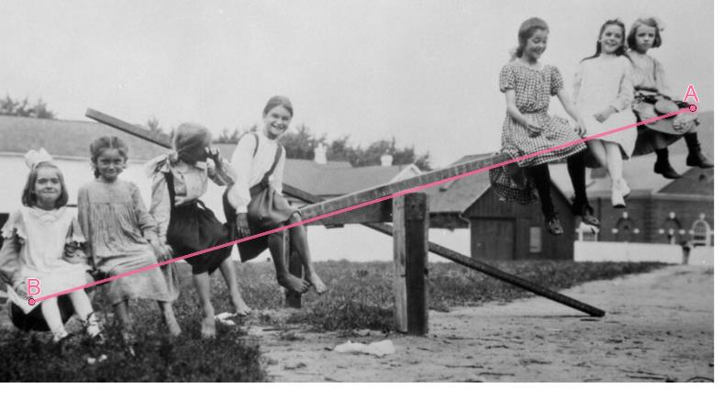
13.5.3 Guided Instruction: Determining Weighted Averages
Weight is a measure of force pushing or pulling on an object due to gravity. This means that finding a weighted average puts more “weight” on one point than another.
If 𝐵 is weighted twice as heavily as 𝐴, then during the calculation, 𝐵 is to measure two times the value of 𝐴. In other words, 𝐵 has two times the “gravitational pull” of 𝐴.
Think of it in terms of a seesaw. In the picture, point 𝐵 is weighted more heavily than point 𝐴.
volume 2, pg. 309

Slide 19
Discuss with your partner what the girls close to point B would have to do so that the seesaw would balance. Summarize your discussion.
volume 2, pg. 309

Slide 20
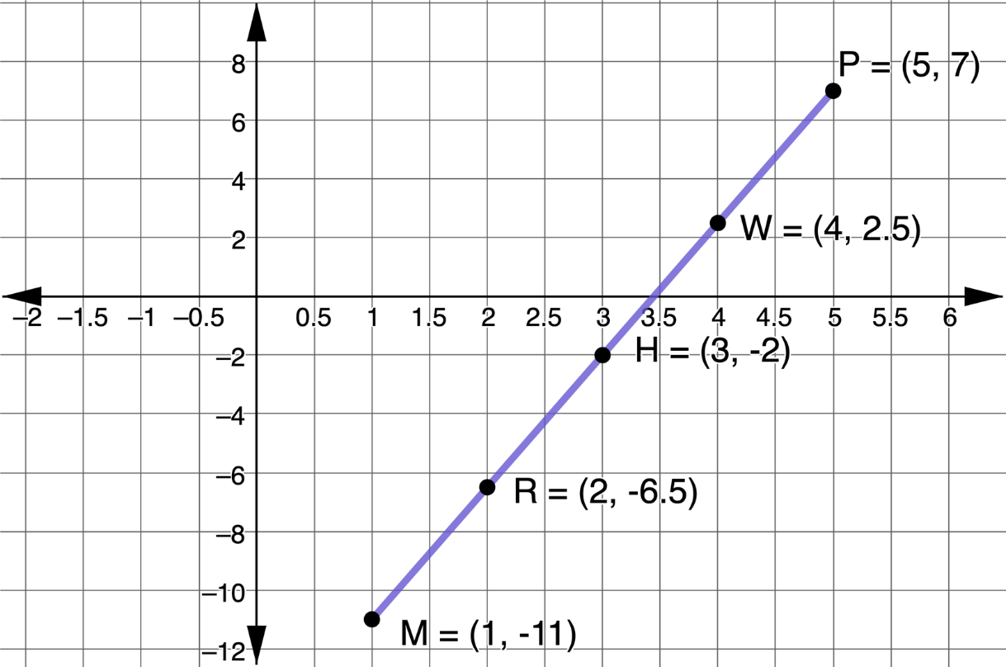
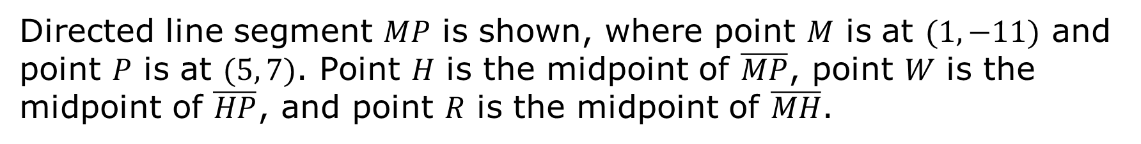
Directed line segment 𝑀𝑃 is shown, where point 𝑀 is at $(1, −11)$ and point 𝑃 is at $(5, 7)$. Point 𝐻 is the midpoint of $\overline{MP}$, point 𝑊 is the midpoint of $\overline{HP}$, and point 𝑅 is the midpoint of $\overline{MH}$.
volume 2, pg. 309

Slide 21
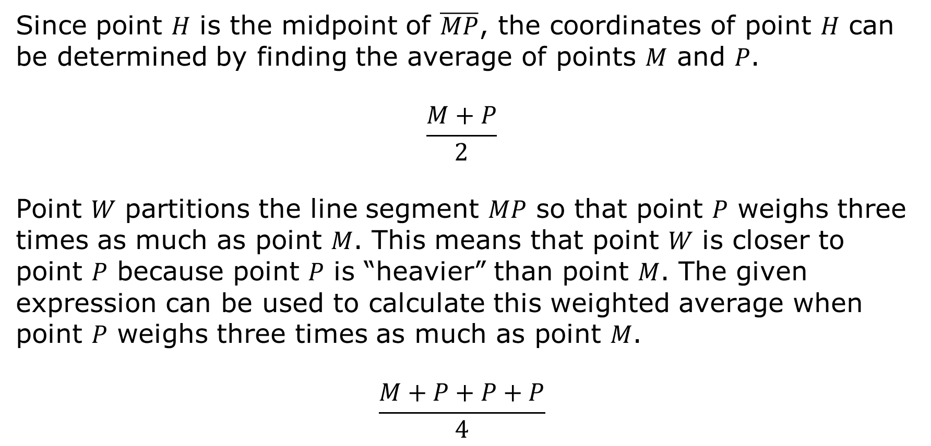
Since point 𝐻 is the midpoint of $\overline{MP}$, the coordinates of point 𝐻 can be determined by finding the average of points 𝑀 and 𝑃.
$$\frac{M+P}{2}$$
Point 𝑊 partitions the line segment 𝑀𝑃 so that point 𝑃 weighs three times as much as point 𝑀. This means that point 𝑊 is closer to point 𝑃 because point 𝑃 is “heavier” than point 𝑀. The given expression can be used to calculate this weighted average when point 𝑃 weighs three times as much as point 𝑀.
$$\frac{M+P+P+P}{4}$$
volume 2, pg. 309

Slide 22
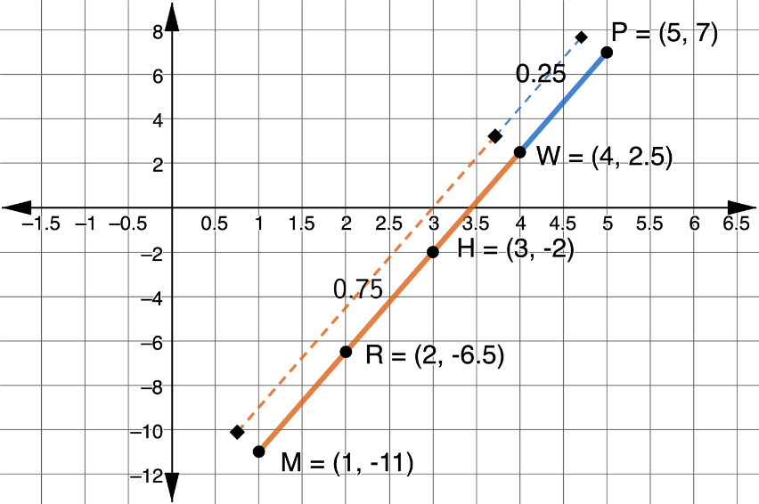
The graph shows the weighted averages.
Discuss with your partner why the distance from point 𝑊 to point 𝑃 is shorter if point 𝑃 is “heavier” than point 𝑀. Summarize your discussion.
volume 2, pg. 310

Slide 23

Point 𝑅 partitions the line segment 𝑀𝑃 so that point 𝑀 weighs three times as much as point 𝑃. Write an expression that shows this weighted average.
A midpoint calculation weighs points on a line segment equally. In a weighted average calculation, points on a line segment can be weighted differently.
volume 2, pg. 310

Slide 24
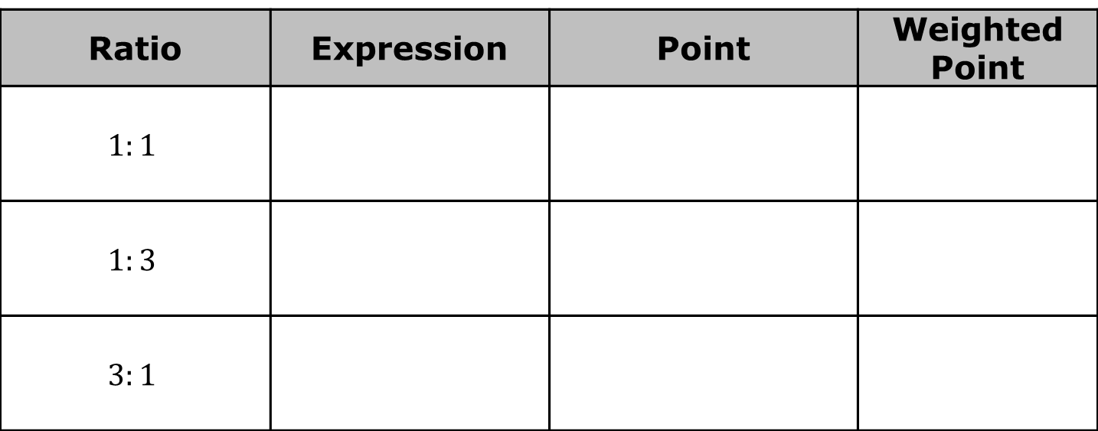
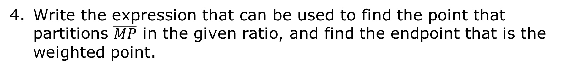
Write the expression that can be used to find the point that partitions $\overline{MP}$ in the given ratio, and find the endpoint that is the weighted point.
Ratio | Expression | Point | Weighted Point
$$1:1$$
$$1:3$$
$$3:1$$
volume 2, pg. 310

Slide 25
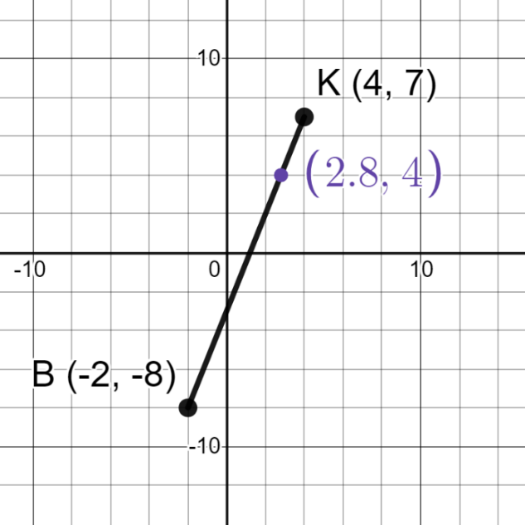
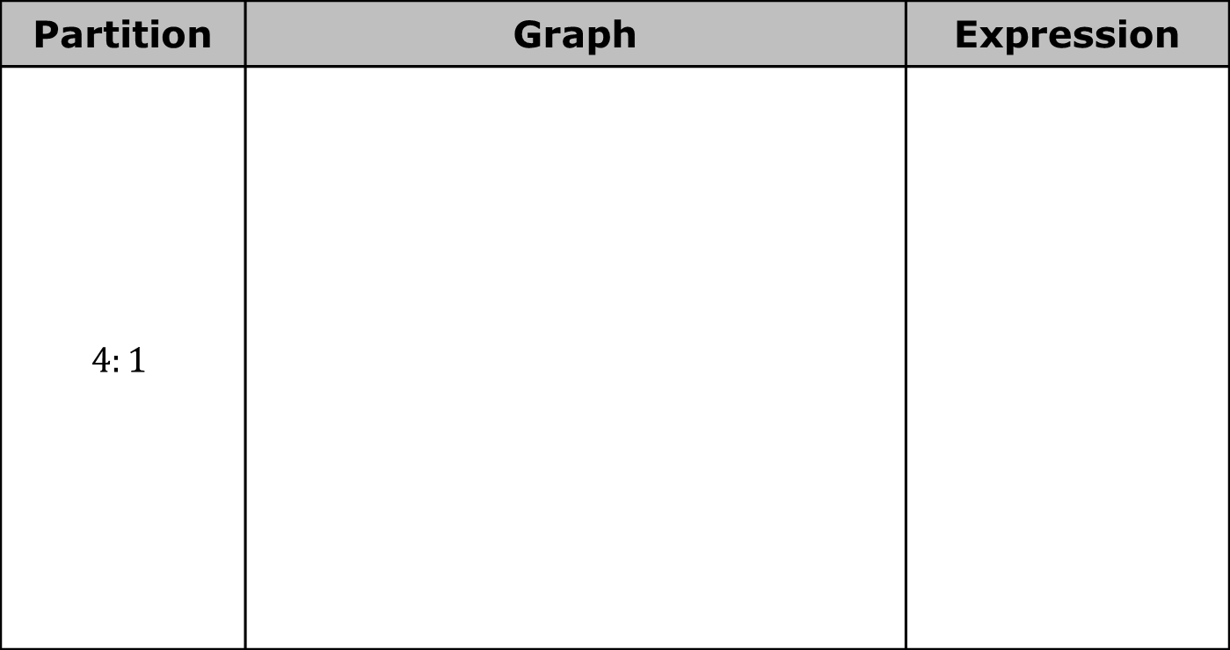
A line segment is shown in the table with three different weighted averages. Write the expression that can be used to find each weighted average.
Partition | Graph | Expression
$$4:1$$
volume 2, pg. 311

Slide 26
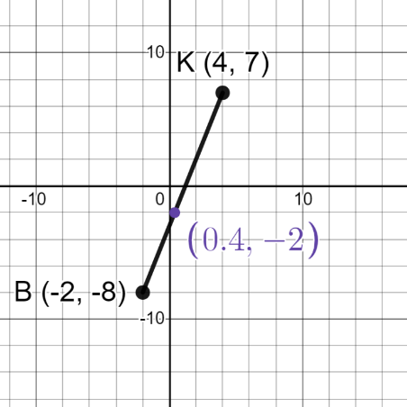

Partition | Graph | Expression
$$2:3$$
volume 2, pg. 311

Slide 27
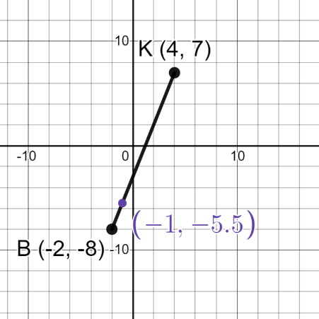

Partition | Graph | Expression
$$1:5$$
volume 2, pg. 311

Slide 28
Discuss with your partner how changing the weights moves the weighted average on the number line. Summarize your discussion.
volume 2, pg. 311

Slide 29

Collaboration
volume 2, pg. 312

Slide 30

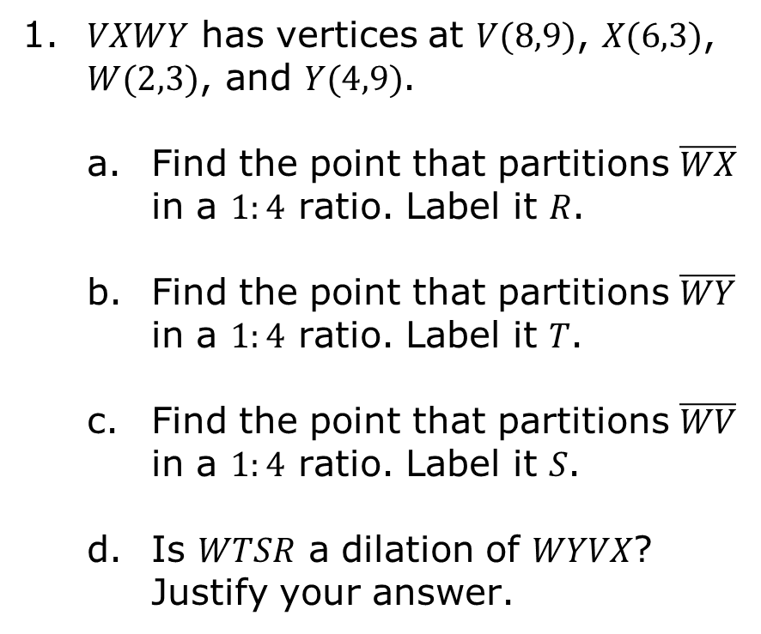
13.5.4 Collaboration: Weighted Averages and Dilations
𝑉𝑋𝑊𝑌 has vertices at $V(8,9)$, $X(6,3)$, $W(2,3)$, and $Y(4,9)$.
Find the point that partitions $\overline{WX}$ in a $1:4$ ratio. Label it 𝑅.
Find the point that partitions $\overline{WY}$ in a $1:4$ ratio. Label it 𝑇.
Find the point that partitions $\overline{WV}$ in a $1:4$ ratio. Label it 𝑆.
Is 𝑊𝑇𝑆𝑅 a dilation of 𝑊𝑌𝑉𝑋? Justify your answer.
volume 2, pg. 312

Slide 31
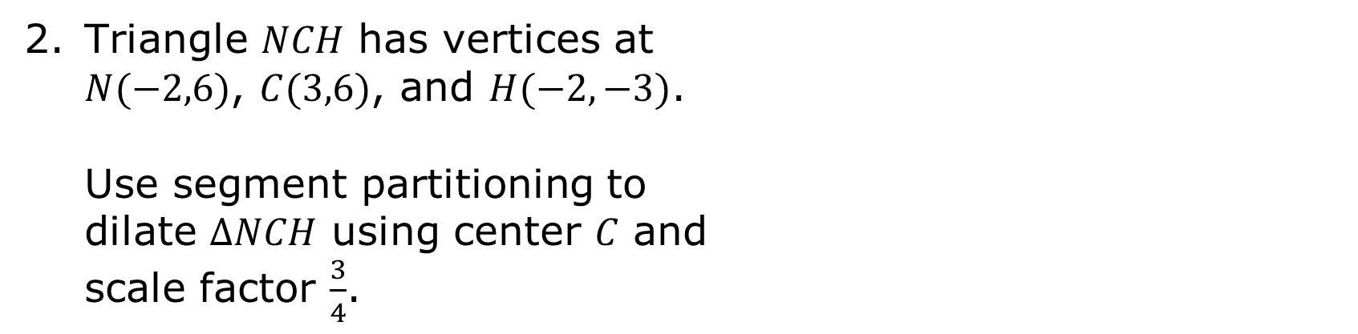
Triangle 𝑁𝐶𝐻 has vertices at $N(−2,6)$, $C(3,6)$, and $H(−2,−3)$.
Use segment partitioning to dilate $∆NCH$ using center 𝐶 and scale factor $\frac{3}{4}$.
volume 2, pg. 312

Slide 32

Your Turn
volume 2, pg. 313

Slide 33
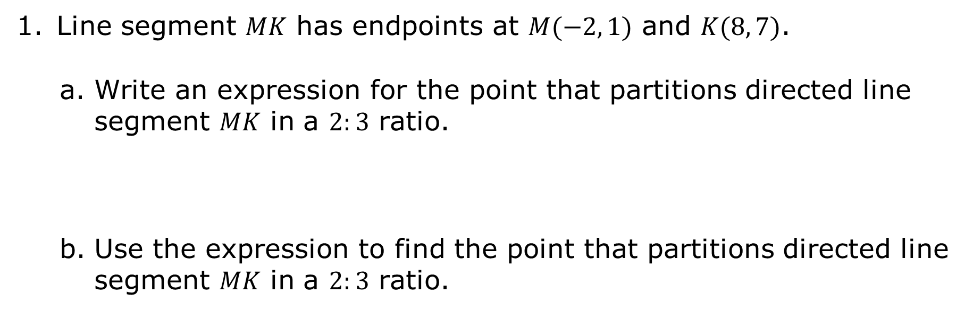
13.5.5 Your Turn!
Line segment 𝑀𝐾 has endpoints at $M(−2, 1)$ and $K(8, 7)$.
Write an expression for the point that partitions directed line segment 𝑀𝐾 in a $2:3$ ratio.
Use the expression to find the point that partitions directed line segment 𝑀𝐾 in a $2:3$ ratio.
volume 2, pg. 313

Slide 34

Wrap-Up
volume 2, pg. 314

Slide 35
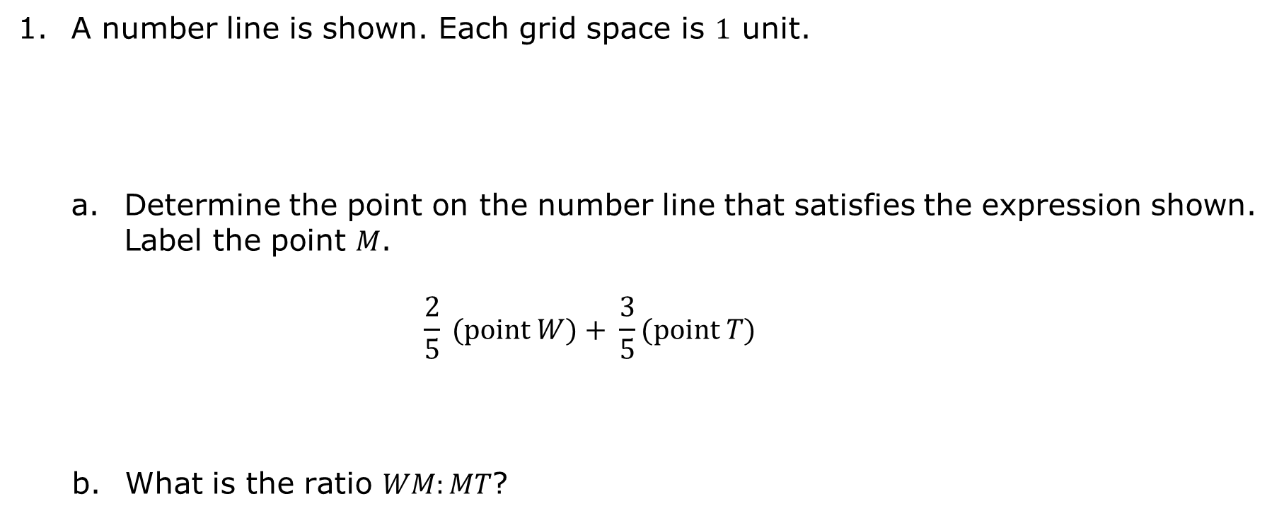
13.5.6 Wrap-Up: Ticket Out the Door
A number line is shown. Each grid space is $1$ unit.
Determine the point on the number line that satisfies the expression shown. Label the point 𝑀.
$$\frac{2}{5} (point W)+ \frac{3}{5}(point T)$$
What is the ratio $WM:MT$?
volume 2, pg. 314

